Slide 1
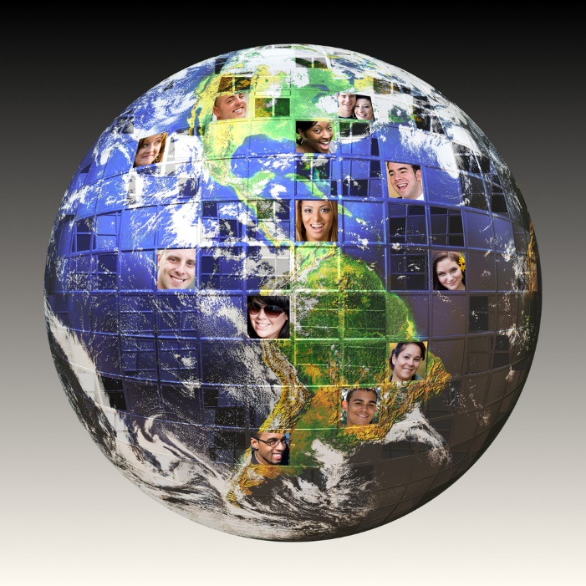
Globalization & Glocalization

Slide 2
What Is Globalization?
Globalization refers to any activity that brings the people, cultures, and economies of different countries closer together.
In business, "globalization" (also called "going global") refers to practices by which organizations become more tightly connected with their customers and partners around the world.
This includes any aspect of operating in different national markets, from product design to marketing.

Slide 3
Globalization: A Few Examples
Online marketplaces like eBay and Amazon make it easy to buy products from businesses or individuals on the other side of the planet. Even products sold in traditional brick-and-mortar stores like Target often make stops in several different countries before reaching their final destinations. Consumer electronics, for example, are commonly sourced from raw materials in India, made in China, then sold in America.
Many large restaurant chains, like McDonald's, operate in dozens of countries. McDonald's specifically has franchises in upwards of one hundred countries, and diners around the world recognize its brand and logo.
Netflix operates in more than 190 countries and customizes content offerings for individual markets with subtitles and programming in local languages.

Slide 4
What Is Glocalization?
Glocalization is a combination of the words "globalization" and "localization." The term is used to describe a product or service that is developed and distributed globally but is also adjusted to accommodate the user or consumer in a local market.
A common example would be cars that are sold worldwide but adjusted to meet local criteria such as emissions standards or what side the steering wheel is located. It could also focus on more cultural aspects, such as a global fast-food chain offering geographically-specific menu items that cater to local tastes.
Often, glocalization campaigns involve culturally friendly media and ad campaigns to encourage the acceptance of foreign products among a local audience.

Slide 5
Glocalization
In regards to a particular product or service, this means the adaptation of globally marketed products and services into local markets.
A global product or service, something everyone needs and can get used out of, may be tailored to conform with local laws, customs, or consumer preferences.
Products that are "glocalized" are, by definition, going to be of much greater interest to the end user, the person who ends up using the product.
This is because while it's something that everyone can use and has use for, as a global product, it's localization makes it more specific to an individual, their context, and their needs.

Slide 6
Glocalization
Glocalization works for companies with decentralized authority structures, and for companies that exist and compete in multiple, different cultural contexts.
The process can be expensive, and resource intensive, but it often pays off for companies that practice it, as it allows for greater access to a larger, more culturally varied target market.
It also makes those countries more effective competitors in those markets.

Slide 7
Key Takeaways
Glocalization is a combination of the words "globalization" and "localization." The term is used to describe a product or service that is developed and distributed globally but is also adjusted to accommodate the user or consumer in a local market.
The process can be expensive and resource-intensive, but it often pays off for companies that practice it.
Often, glocalization campaigns involve culturally friendly media and ad campaigns to encourage the acceptance of foreign products among a local audience.

Slide 8
Cross culture communication

Slide 9


Slide 10
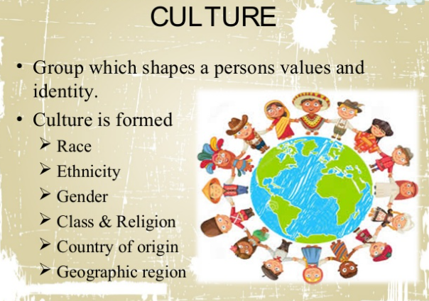

Slide 11
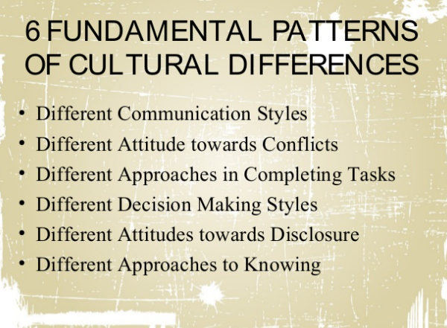

Slide 12


Slide 13
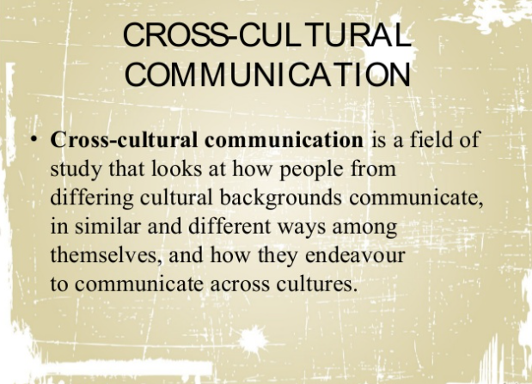

Slide 14
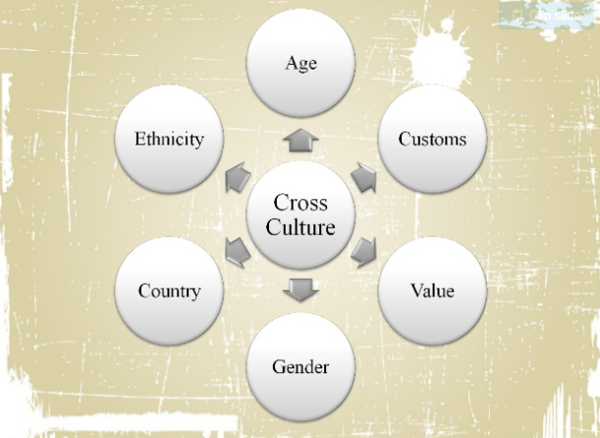

Slide 15
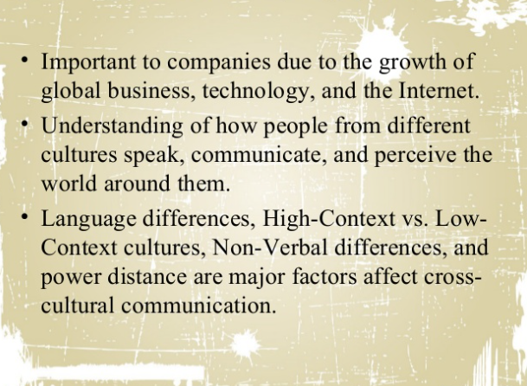

Slide 16
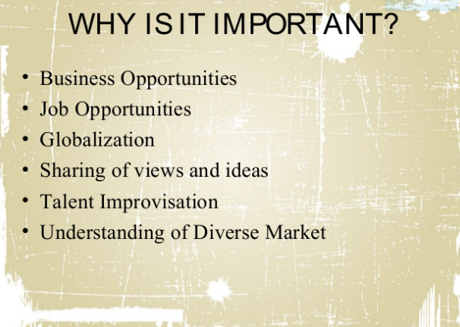

Slide 17
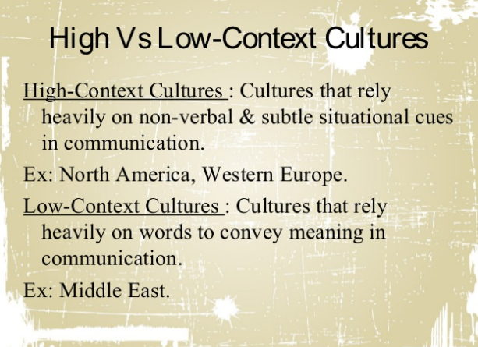

Slide 18
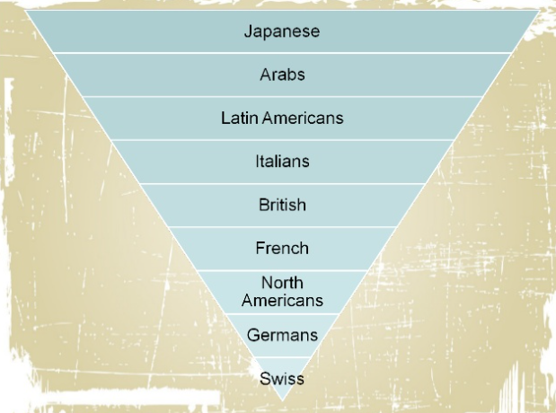

Slide 19
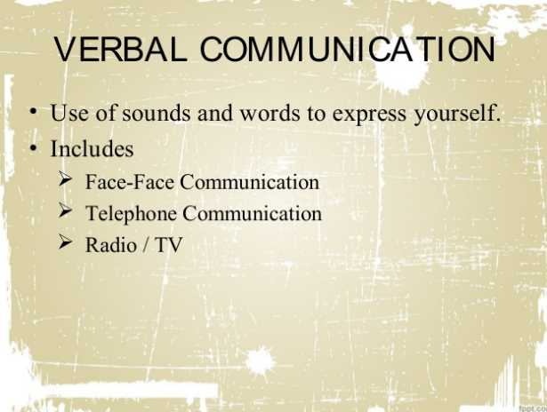

Slide 20


Slide 21


Slide 22


Slide 23
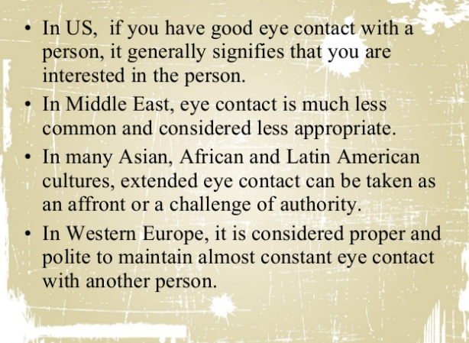

Slide 24
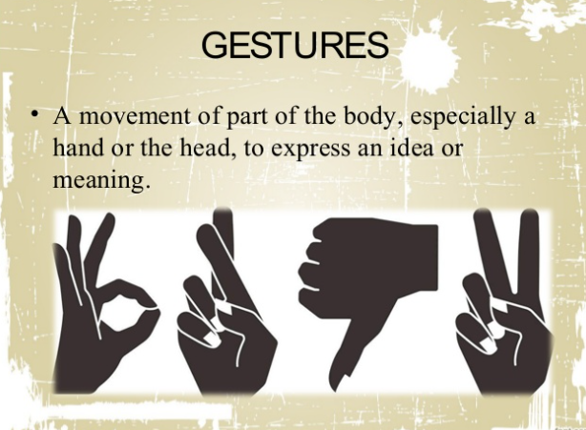

Slide 25


Slide 26


Slide 27
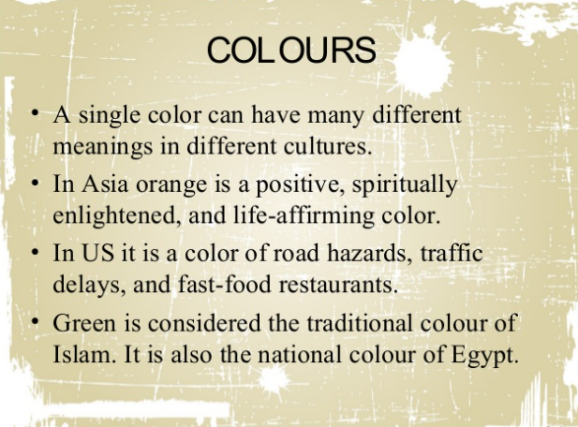

Slide 28
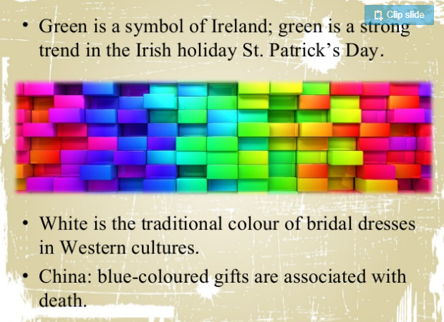

Slide 29
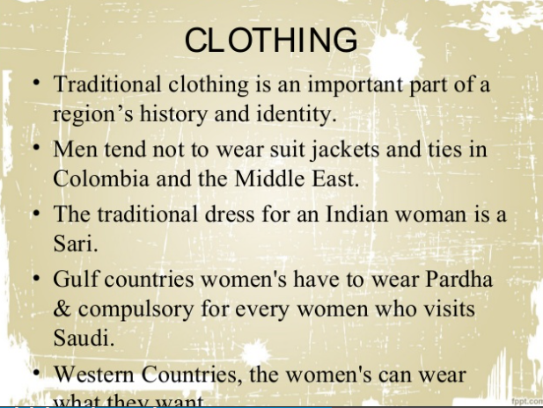

Slide 30
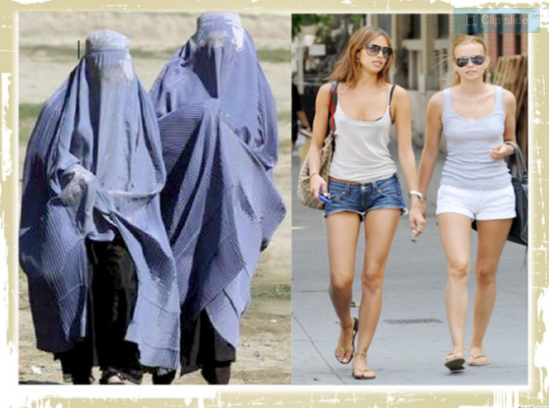

Slide 31
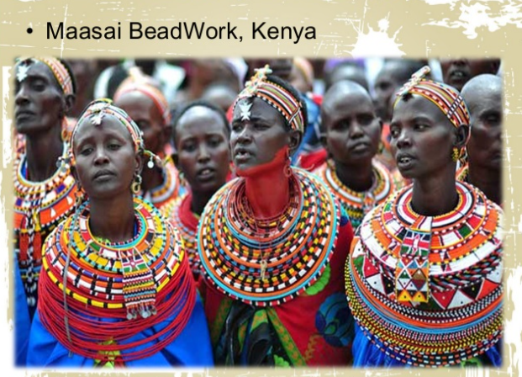

Slide 32
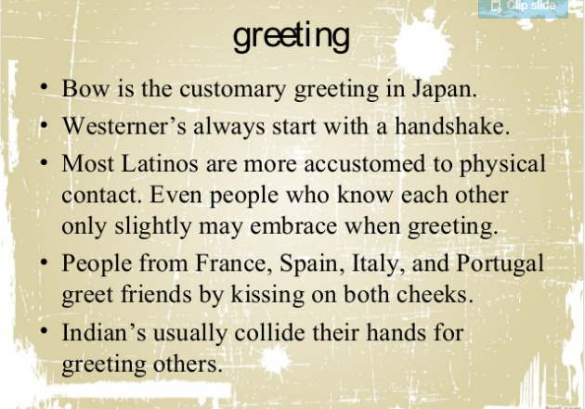

Slide 33


Slide 34


Slide 35
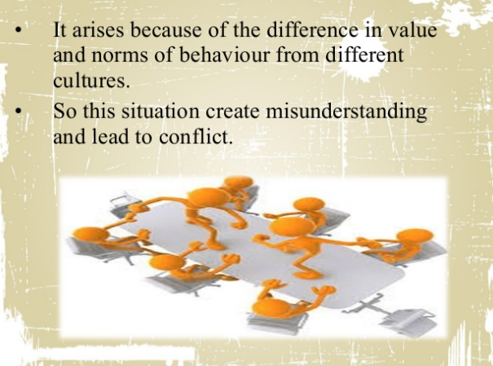

Slide 36
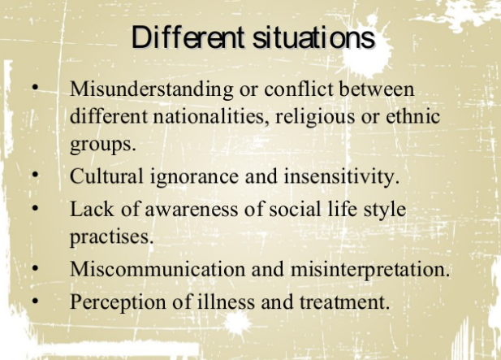

Slide 37
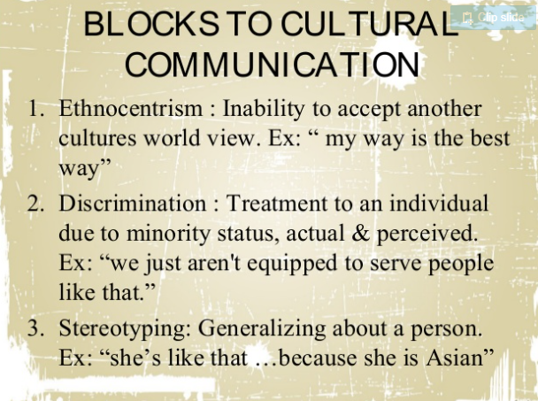

Slide 38
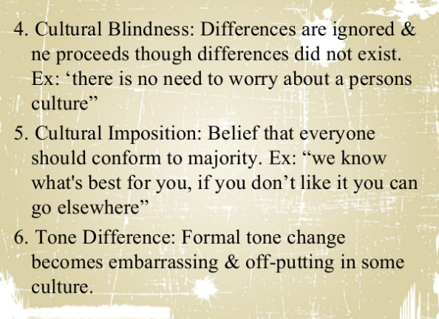

Slide 39
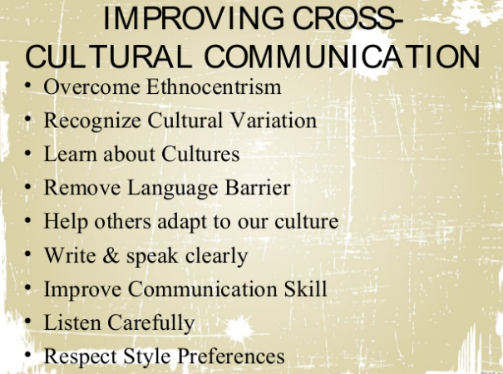

Slide 40
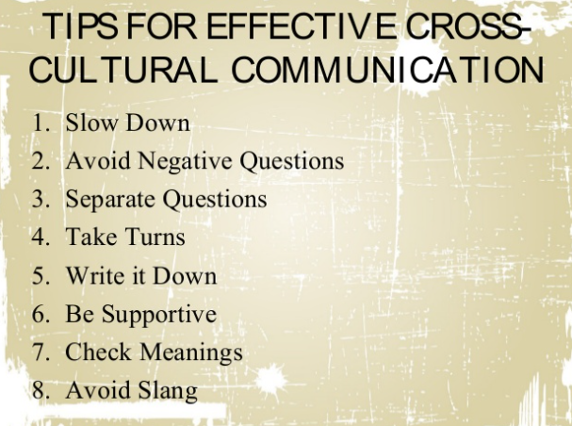

Slide 41


Slide 42
